Slide 1

Gender, Roles & Careers: Exploring Congruity Theories
Rashi Gupta
2024 July 25

Slide 2

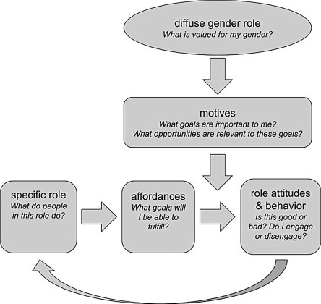
Why this topic ? (LSAY dataset)
1- What are gender disparities in career trajectories ?
11- How does gender-minority status impact career changes during emerging adulthood?(like nursing and labour major fields along with STEM fields )
Note: Understanding these questions is crucial for promoting gender diversity and inclusion in education and the workforce.
2

Slide 3
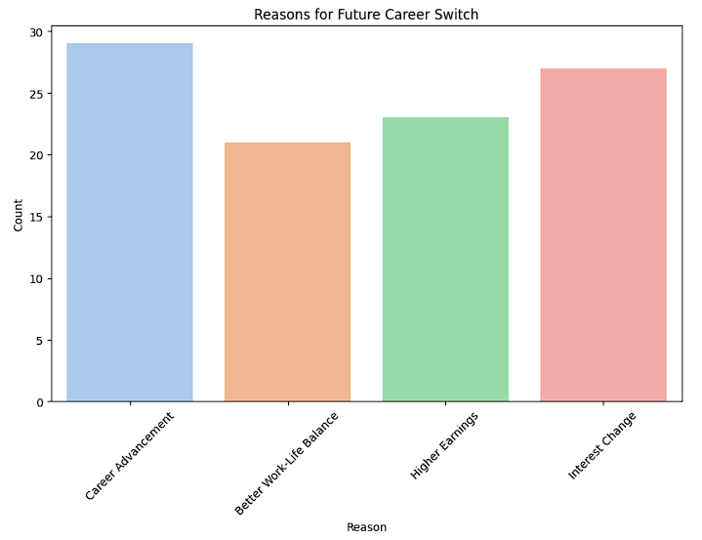
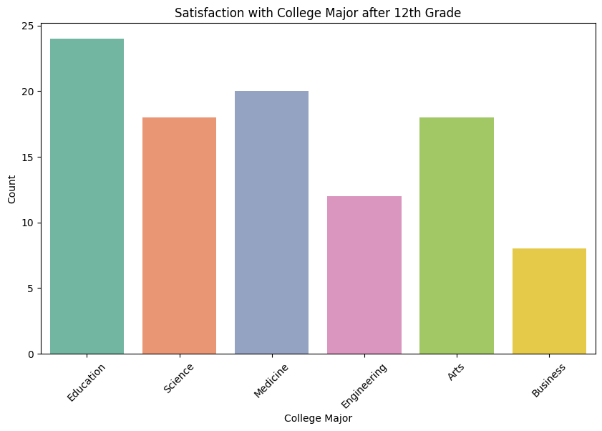
Key Findings :
As students progress through their grades, their interest in various fields generally increases. However, this growing interest often leads to greater uncertainty and indecision when making final career choices.
4o

Slide 4
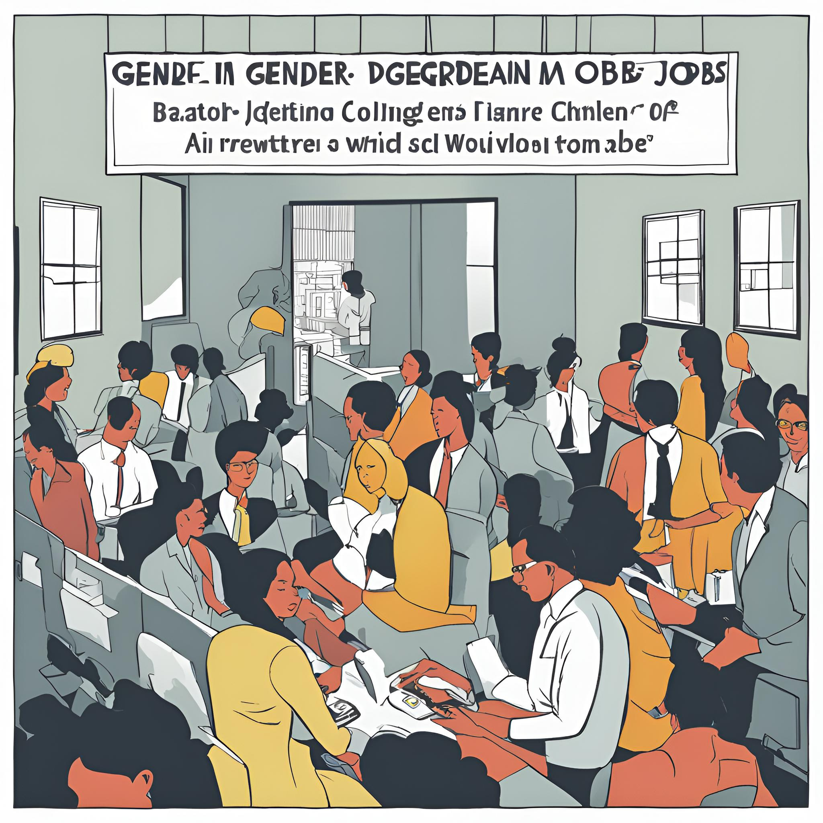
Key Points for Each Grade
7th Grade: Setting the Stage for Gender Perceptions
Subject Preferences and Teacher Influence: Boys show a stronger preference for Math and Science, while girls have a more balanced interest across subjects.
8th Grade: Shaping Gendered Career Aspirations
Career Aspirations and Gender Stereotypes: Boys lean towards STEM fields, and girls towards humanities and social sciences, reflecting traditional gender roles.
9th Grade: Cementing Gendered Interests
Subject Preferences and Gender Dynamics: Boys exhibit higher interest in STEM subjects, while girls prefer humanities, reinforcing entrenched gender roles.

Slide 5

Variables Utilised :
Several variables were utilized, including subject preferences, teacher influence, parental expectations, gender roles, career aspirations, gender stereotypes, grades, enjoyment, and gender perceptions.
Methods Used :
We employed predictive modeling to analyze the interests of boys and girls in each grade and compared these predictions with their actual college majors after completing their preliminary education.

Slide 6

Thank you
for listening!
Rashi Gupta
2024 July 25

